Slide 1

"AI-Based Dental Intelligence System for Automated Detection and Diagnosis of Dental Diseases"
Final Year Project – Proposal Presentation
By
[Rehan Mahmood Farooqi – NUM-BSCS-2022-49]
Supervisor: Ammar Ahmad
Industrial Partner: HSA Islamabad

Slide 2
Outline
Introduction
Literature Review/Background/Related Existing Products
Problem Statement and Objectives
Proposed Design Methodology/Framework/Architecture
Hardware/Software Tools
Proposed Work Plan (Gant Chart)

Slide 3
Introduction
Dental health is an essential part of overall human well-being, influencing nutrition, speech, and confidence.
Despite advancements in dentistry, dental diseases such as cavities, gum infections, and periodontal issues remain common worldwide.
Traditional diagnosis
Artificial Intelligence (AI) and Deep Learning (DL) enable automated and precise dental image analysis.
These technologies can identify patterns, detect diseases early, and support clinical decision-making.

Slide 4
Problem Statement
Millions of people suffer from untreated dental diseases such as cavities, gum infections, and oral lesions.
Early diagnosis is critical to prevent complications, pain, and expensive treatments.
Traditional diagnostic methods rely on manual X-ray and image inspection by dentists.
Subjective
Time-consuming
Error-prone
Limited in accessibility
There is a need for an intelligent, automated, and standardized diagnostic system to assist dentists in accurate and efficient disease detection.

Slide 5
Literature Review/Background/Related Existing Products
Author(s) / Year | Focus Area | Model / Technique Used | Key Contribution / Findings
Suvarna Bhat et al. (2023) | Comprehensive survey of deep learning in dental radiograph analysis | CNN, ResNet, Transformer-based architectures | Highlighted that deep learning models outperform traditional diagnostic methods in accuracy and efficiency.
Man Hung et al. (2024) | Dental caries detection from panoramic imaging | Deep CNN models | Demonstrated that CNN-based models achieve high diagnostic accuracy compared to manual diagnosis.
Nader Nabil et al. (2025) | Periodontal bone loss detection using AI | Two-stage AI framework (Segmentation + Classification) | Proposed a robust AI-based method for precise detection of bone loss and periodontal disease.
Hasnain et al. (2024) | Multi-disease classification in dental diagnosis | Hybrid Deep Learning Architecture | Developed a model that can classify multiple dental diseases simultaneously with high accuracy.
Yassir Almalki et al. (2023) | Dental disease classification using OPG X-rays | CNN-based architectures | Achieved strong performance in detecting and classifying various dental conditions using Orthopantomography images.

Slide 6
Proposed Design Methodology/Framework/Architecture
Goal: Build an AI system to detect & classify dental diseases from X-rays, intraoral photos, and CBCT.
Image input → Preprocessing → Model training (multiple architectures) → Evaluation & selection → Explainability → Deployment
Input & Ingestion : Accept dental X-rays, intraoral images, CBCT; standardize formats and sizes
Preprocessing : Noise reduction, contrast enhancement (CLAHE), normalization, ROI extraction
Model Development : Classification & detection options
Model Evaluation : Accuracy, Precision, Recall, F1-score.
Explainability : Grad-CAM, Attention Visualiztions
Post-processing & Reporting : Confidence scoring, bounding boxes/heatmaps, auto-generated summary report

Slide 7
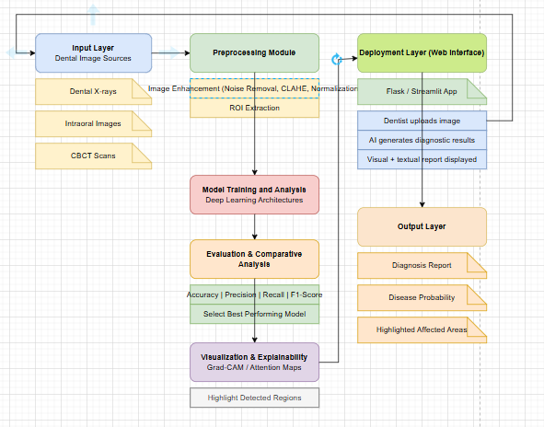

Slide 8
Software Tools
Software Tool | Purpose / Use | Why Chosen
Python | Primary programming language for AI development | Rich ecosystem for ML & DL, flexible, strong community support
TensorFlow / PyTorch | Building, training, and comparing deep learning models (CNN, ResNet, YOLOv8, ViT) | Supports various architectures, pre-trained models available
OpenCV | Image preprocessing (noise removal, enhancement, normalization) | Efficient image processing and computer vision operations
scikit-learn | Performance metrics and model evaluation (accuracy, precision, recall, F1-score) | Easy-to-use, widely adopted, integrates with ML pipelines
Flask / Streamlit | Web-based interface for model deployment and testing | Simple, fast deployment, enables real-time interaction
Google Colab / Jupyter Notebook | Training models with GPU acceleration and experimentation | Provides free/paid GPU, interactive coding environment

Slide 9
Proposed Work Plan
Activity | Tentative Date
Literature Review & Problem Understanding | Oct – Nov 2025
Dataset Collection & Preprocessing | Nov – Dec 2025
Model Development & Training | Dec 2025 – Feb 2026
Comparative Analysis & Model Evaluation | Feb – Mar 2026
System Integration & Deployment | Mar – Apr 2026
Testing & Optimization | Apr – May 2026
Documentation & Final Report Preparation | May 2026

Slide 10
Gantt Chart
Task | Oct 2025 | Nov 2025 | Dec 2025 | Jan 2026 | Feb 2026 | Mar 2026 | Apr 2026 | May 2026
Literature Review & Problem Understanding | ■ | ■
Dataset Collection & Preprocessing |  | ■ | ■
Model Development & Training |  |  | ■ | ■ | ■ | ■
Comparative Analysis & Evaluation |  |  |  |  | ■ | ■
System Integration & Deployment |  |  |  |  |  | ■ | ■
Testing & Optimization |  |  |  |  |  |  | ■ | ■
Documentation & Final Report Preparation | ■ | ■ | ■ | ■ | ■ | ■ | ■ | ■

Slide 11
Thank You

